Slide 1

Securing Open Source Software
End-to-end, At massive scale, Together
#ossummit
@WhyHiAnnabelle & @SecurityCRob

Slide 2
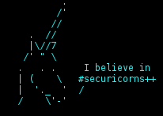
Why we brought you all here today….
About us
Defining the scope
Threat Factors of the Open Source
A Modest Proposal
Q&A

Slide 3


[us@ossummit.usa ~]$ ./HelloWorld.sh
CRob, n, adj, and v (@SecurityCRob)
Pronunciation: U.S. (K-robe)
Over 25 years of Enterprise-class Architecture, Engineering, Operations, and Security experience
Ambassador For Intel Product Assurance and Security
Working Group lead for the OpenSSF Dev Best Practices & Vuln Coordination WGs, OpenSSF TAC and Public Policy Committee, FIRST PSIRT TPC WG, and others
Co-Author FIRST PSIRT Services Framework & others
Pirate-enthusiast & hat-owner
Anne Bertucio (@WhyHiAnnabelle)
Lead for Google’s Open Source Programs Office (OSPO) Program Dev team
We help Googlers release open source and contribute to open source
Includes promoting good security practices (like vuln disclosure!)
Member of OpenSSF Vuln Disclosure WG
Previously: Kata Containers and OpenStack contributor, very mediocre bicycle racer
The thoughts and feels expressed here are personally held or experientially earned, and not necessarily those of our employers
Notes:
JF, CR
Jennifer Fernick
SVP & Global Head of Research at NCC Group
Co-founding Governing Board/TAC member for the Open Source Security Foundation
Prev: Cryptographer and quantum computer scientist
I also previously was a security architect and later led the security team at a large global bank
My academic background is in quantum computing, systems engineering, and artificial intelligence

Slide 4
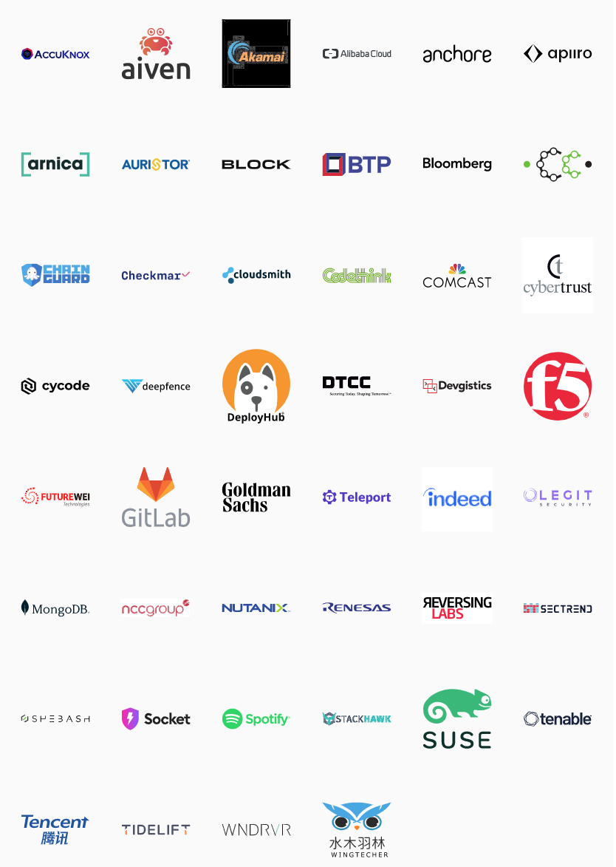
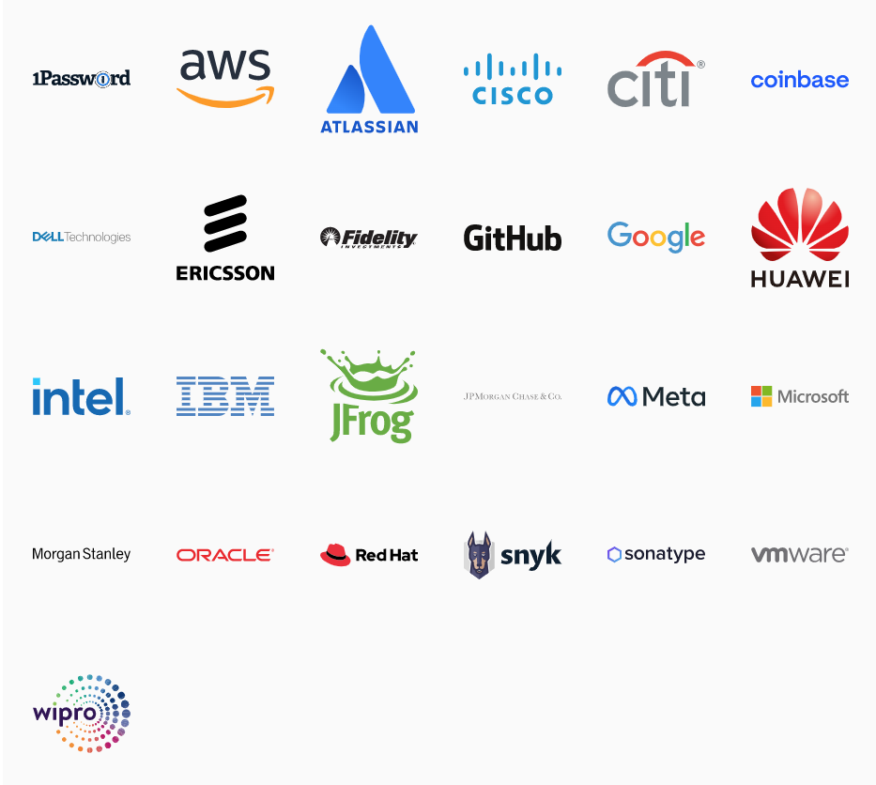


Open Source Security Foundation (OSSF)
General Members
OpenSSF is committed to collaboration and working both upstream and with existing communities to advance open source security for all.
openssf.org
Premier Members
Associate Members
Notes:
JF/CR?
[We’re sharing lessons from openssf but not speaking for particular member companies]

Slide 5
End-to-End
Notes:
CRob

Slide 6
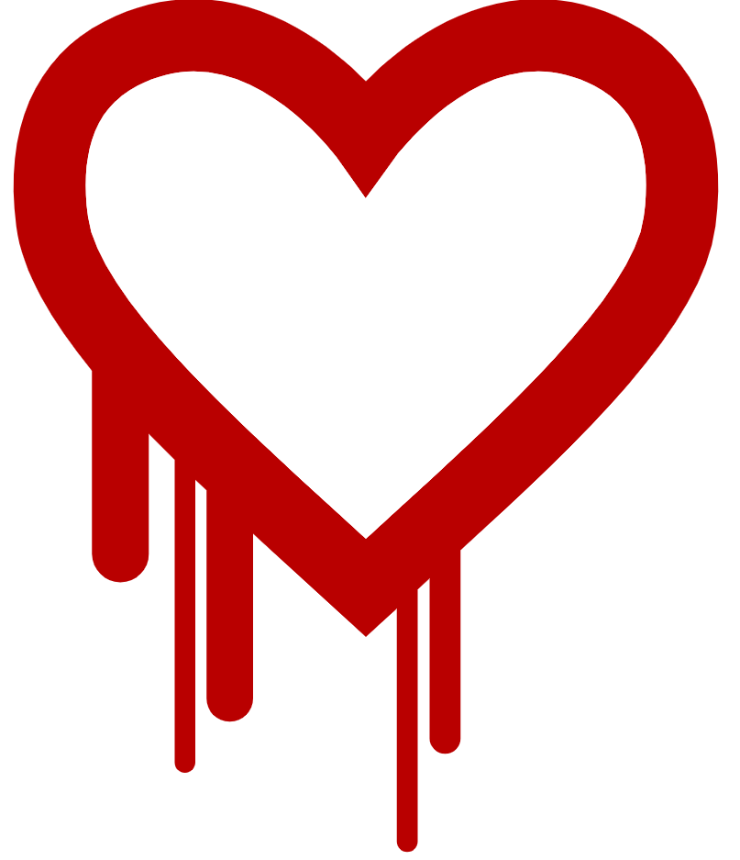
CVE-2014-0160
https://heartbleed.com/
Vulnerability in popular open source library OpenSSL that could leak sensitive information otherwise thought protected by SSL/TLS encryption
This is a widely-used method to protect communications over TCP-IP-based networks (example - The Internet)
”At the time of disclosure, some 17% (around half a million) of the Internet's secure web servers certified by trusted authorities were believed to be vulnerable to the attack, allowing theft of the servers' private keys and users' session cookies and passwords” ⁽⁷⁾
Public disclosure - 7 April 2014
Exposure -
21 June 2014 - 309,197 public web servers remained vulnerable ⁽⁸⁾
6 July 2017, the number had dropped to 144,000 ⁽⁹⁾
11 July 2019, 91,063 devices were vulnerable ⁽¹⁰⁾
(7) - Heartbleed
(8) - 300k vulnerable to Heartbleed two months later
(9) - Heartbleed’s Heartburn: Why a 5 year Old Vulnerability Continues to Bite
(10) - Heartbleed Report
At the time, OpenSSL had TWO full-time developers to develop, maintain, test, and review 500,000 lines of code ⁽⁷⁾
Notes:
CR

Slide 7
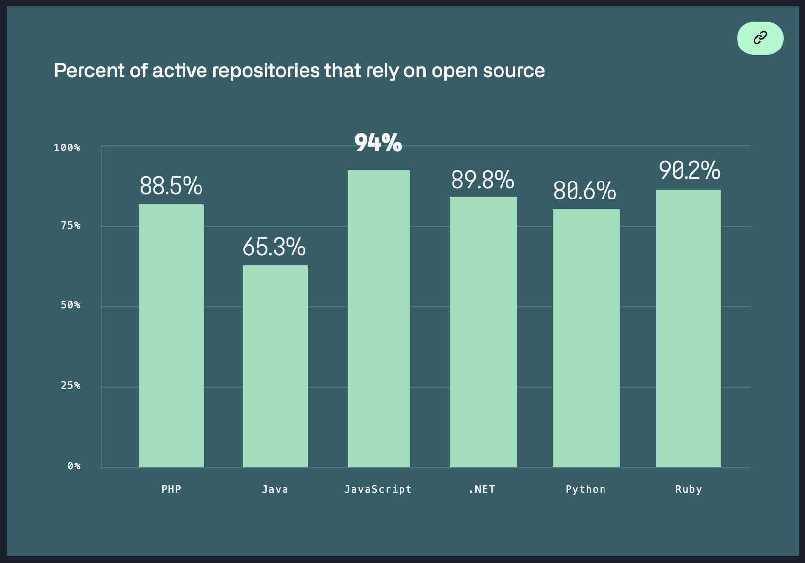
Problem Overview - Securing the open source ecosystem
It has been estimated that FOSS constitutes 80-90% of any given piece of modern software ⁽¹⁾
One report found that 84% of these codebases had at least one vulnerability, with the average having 158 per codebase ⁽²⁾
Other reports discover that average applications contain 118 libraries with roughly ⅓ being active; The average library age was 2.6 years old ⁽³⁾
Over a 10 year period the volume of vulns has increased over 4 times [as measured with CVE] ⁽⁴⁾
Most OSS vulns are discovered in indirect dependencies ⁽⁵⁾
A typical vuln can go undetected for 218 weeks, and typically takes 4 weeks to get resolved once the project is alerted to it ⁽⁶⁾
Image - %Rely on OSS
(1) - State of the Software Supply Chain
(2) - 2021 Open Source Security and Risk Analysis Report
(3) - 2021 State of Open Source Security Report
(4) - 2020 Red Hat Risk Report
(5) - 2020 State of Open Source Security Report
(6) - 2020 State of the Octoverse
Notes:
CR? Source for chart, “Percent of active repositories that rely on open source”: https://octoverse.github.com/#chart-rely-on-oss (data from “This analysis included public open source repositories with at least one contribution in each month between 10.1.2019 and 09.30.2020.”)
Why does securing the open source ecosystem matter?
Open source software is a significant part of the core infrastructure in most enterprises in most sectors around the world, and is foundational to the internet as we know it. Consequently, it represents a massive and profoundly valuable attack surface. The Heartbleed vulnerability in OpenSSL disclosed in April 2014 showed us what this risk looks like in practice - a single critical vulnerability, found within an individual open source project maintained by only a few volunteers, compromised the security nearly one-fifth of the webservers on the internet.
In 2019, over 16000 vulnerabilities were disclosed and assgned CVE numbers across proprietary and open source software, and over 1000 of those were scored “critical”. Vulnerabilities are not rare. We need to systematically reduce them, especially in widely-used software. We also need to better understand the threat landscape for open source projects, and help make security easier or default whenever possible, so we can reduce the risk of developers focussing on the features that they care about most.
“According to Gartner over 95% of the IT enterprises across the globe use open source software (OSS) for their mission-critical IT workloads, whether they are aware of it or not.” (source: https://github.com/readme/featured/octoverse-security)

Slide 8
Backend to Middleware to Frontend
“According to a U.S. Department of Homeland Security advisory, the affected versions of SolarWinds Orion are versions are 2019.4 through 2020.2. 1 HF1. More than 18,000 SolarWinds customers installed the malicious updates, with the malware spreading undetected” - TechTarget - June 16, 2021
“Log4j 2.x is in the top 0.003% percentile in popularity by downloads out of a total population of 7.1 million.
In short - it's as popular as components get.” - Sonotype - “Log4shell by the numbers- Why did CVE-2021-44228 set the Internet on Fire?” - December 14, 2021
“Unpatched open source software flaw blamed for massive Equifax breach.
It’s no surprise that Web application attacks are the leading cause of large breaches. The *average* Web application or API has 26.7 serious vulnerabilities. And organizations often have hundreds, thousands, or even tens of thousands of applications.”
eSecurity Planet - December 12, 2017

Slide 9
At Massive Scale
Notes:
Anne

Slide 10
What makes OSS a unique target for adversaries?
Many of the best things about open source development invite unique security challenges:
Deobfuscated and public-facing source code lowers attacker barrier to entry
Distributed community-driven development with contributions from unknown third-parties
Tragedy of the commons regarding security analysis
Lack of consistently-deployed security standards, reviews and tooling
(Often) decreased capacity for vulnerability remediation
Lack of resources for monitoring & typical underpreparedness for incident response
Different economic incentives & feedback loops than: enterprise devs; threat actors
In spite of this: many high-value targets, foundational to enterprises and the internet itself
Notes:
What makes open source software a unique target for adversaries?
What makes open source so impactful, is also what makes it difficult to secure.
Deobfuscated and public-facing source code as opposed to proprietary/closed source software for which an attacker must reverse engineer the binaries
Distributed community-driven development, where contributions come from many sources including, at times, unknown third-parties
At times, a “tragedy of the commons” where we assume that software is secure because anyone could have looked at it and found bugs - but we’re not actually assured, in many cases, that anyone has
A lack of consistently-deployed security standards, reviews and tooling, resulting in weaknesses at various points in the SDLC, even where “easy wins” for security, such as listing vulnerability disclosure contact information, is not present.
In many cases, decreased capacity for vulnerability remediation, and even worse incident response, particularly in smaller projects or in those without a mature security program.
Entirely different economic incentives and allocation of human and financial resources compared to industrial software development, where security is often not incentivized or accounted for, as well as compared to threat actors
But in spite of all of this, high-value targets that are foundational to many of the technologies that power our world and to the internet itself.

Slide 11
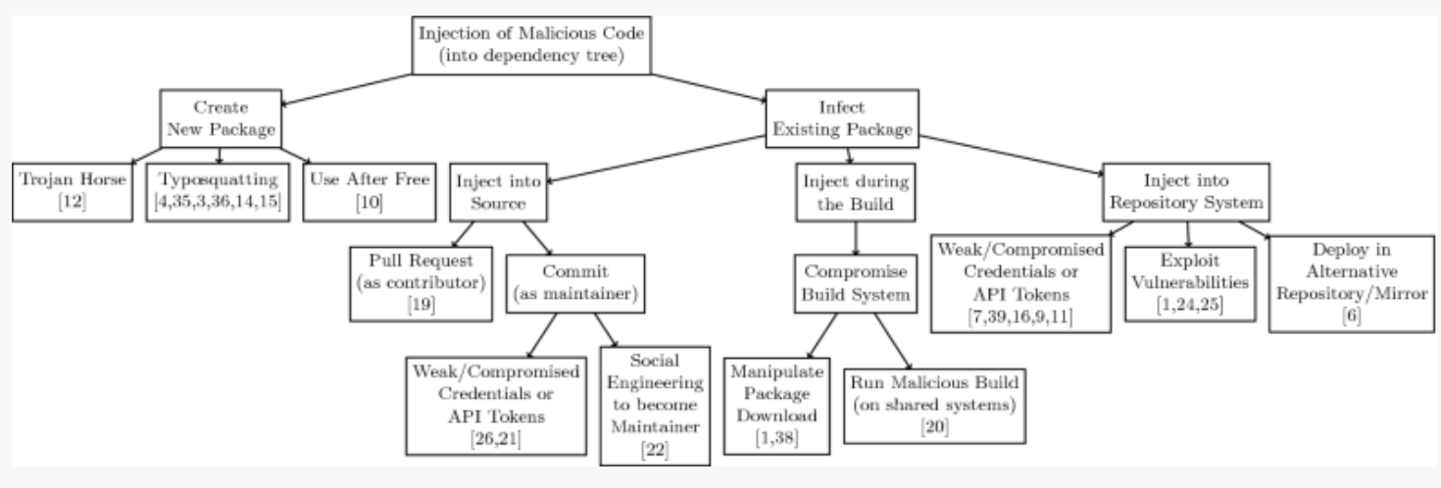
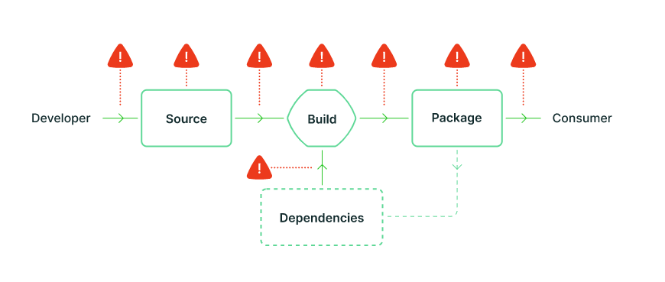
OSS security is about more than just vulnerabilities in source code
Source: Backstabber’s Knife Collection: A Review of Open Source Software Supply Chain Attacks (2020)
Source: slsa.dev
Notes:
When threat modelling OSS, we have a broad attack surface that begins before any code is written, and extends to every individual developer’s local machine and network, all the way through the broader project infrastructure, and beyond into the package management ecosystem
Concept phase
Think about intrinsic risk related to your entire tech stack
Focus on areas of enhanced risk - cryptography & secrets management, OS kernels, etc
Local development on maintainer’s machine in the interest of making malicious commits to a repo, or to preview forthcoming changes or otherwise exfiltrate information
have seen examples of malware which sought to exfiltrate a devs npm access tokens
as well as the XcodeGhost supply chain attack in 2015 in which malicious versions of Apple’s Xcode development environment were distributed
Infrastructure / Project level
Mistakes in code:
Copy-pasting insecure code from stackoverflow
Using insecure development practices
Committing secrets to source code or packages
Abuse of debug privileges and development-related backdoors by threat actors, and other abuses by external contributors
External contributors who may introduce malicious code, either independently or through compromise of a legitimate developer’s contirbutions
Compromises to - or insufficiently robust pairing between - developer identity and authentication
Insecure CI/CD pipelines in which a range of attacks can occur; compromises of build systems
There has been great work around Build pipelines and verification, including work around reproducible builds and binary transparency
Problems amplified by a Lack of build pipeline security tooling: static analysis; fuzzing
Lack of platform security, OS-level protections, and runtime protecions
Package Ecosystem
Typosquatting to insert malicious packages
Direct compromise of legitimate packages
Use of malicious dependencies
Vulnerability disclosure
Inaccurate security contact
Unmaintained project
Maintainer does not see the bug as a security vulnerability, or is unable to write the patch
Insecure communications methods, including projects’ desire for vulnerabiities to be reported as public issues
Patching in public may allow RE in advance of forthcoming patches to infer not-yet public vulnerabilities
I would direct the interested listener to the “Threats, Risks, and Mitigations in the Open Source Ecosystem” published by Michael Scovetta of Microsoft and several collaborators from OpenSSF. https://github.com/ossf/wg-identifying-security-threats/blob/main/publications/threats-risks-mitigations/v1.1/Threats%2C%20Risks%2C%20and%20Mitigations%20in%20the%20Open%20Source%20Ecosystem%20-%20v1.1.pdf

Slide 12
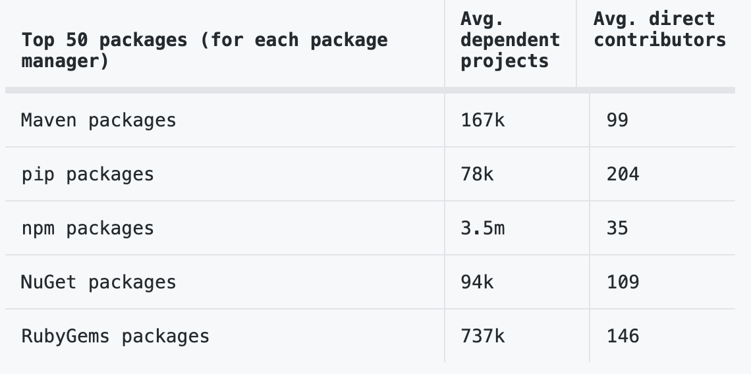


Open source projects have an average of 180 package dependencies
The top 50 OSS projects with the most downstream dependencies had an average of 3.6 million projects dependent upon them
Source: Github State of the Octoverse 2019
Vulns in OSS have been central to major breaches and some of these vulns were not found until decades after their creation
Vulns in your code
Vulns in your code’s code
Notes:
Let’s talk about transitive dependency risk. Even if your code is free of vulnerabilities, your code likely depends on something which itself is full of vulns. Vulns on vulns. Vulns all the way down
Open source projects have an average of 180 package dependencies. But this number can range from just a few packages to more than 1,000. (source: Github State of hte Octoverse 2019)
The 50 open source projects with the most dependent projects each had an average of 3.6M+ dependents. This data is based on content from manifest files in public repositories with open source licenses. (Source: Github State of the Octoverse 2019)
CVE-2017-5638, a vulnerability in the open source Apache struts framework, was exploited in the breach of Equifax, which resulted in the unauthorized disclosure of 200,000 credit card numbers (source: https://debricked.com/blog/vulnerabilities-dependencies/)
npm package event-stream attack: The alleged attacker was givenownership of this popular npm package simply by asking the original developer to take over its maintenance. This was a package used by 1,600+ other packages, and was downloaded 1.5 million times a week on average (source: https://link.springer.com/chapter/10.1007%2F978-3-030-52683-2_2)
Oh, and these things arent always quickly remediated - Shellshock existed in bash for 22 years before it was found

Slide 13
The creation of potentially exploitable vulnerabilities increasingly outpaces the rate at which we can search for and remediate them, and this problem is one that only gets worse with time.

Slide 14
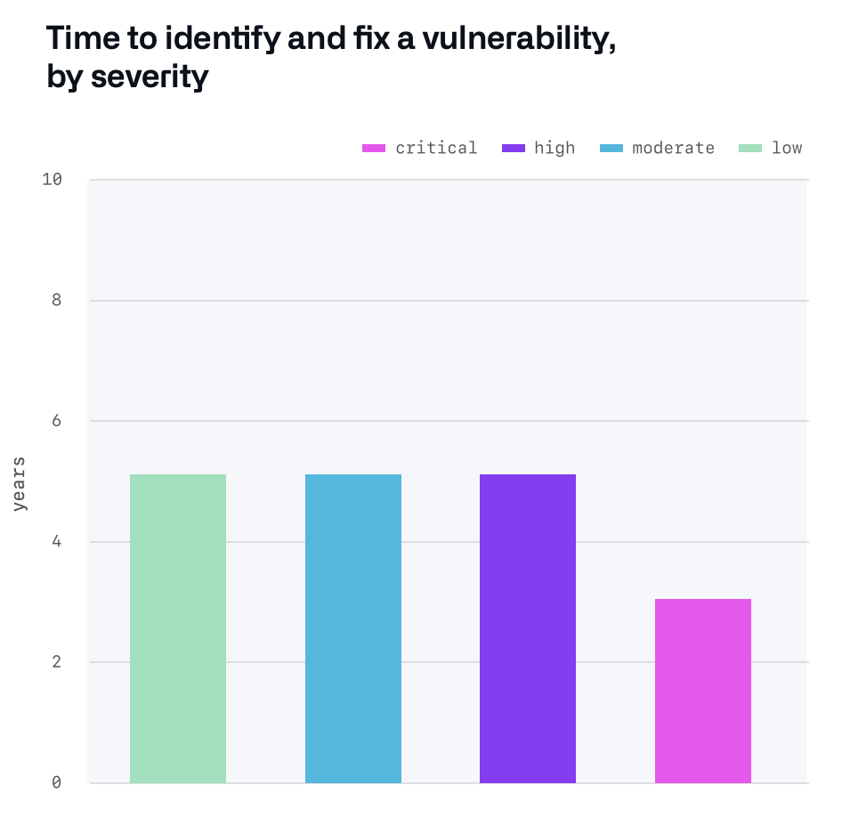
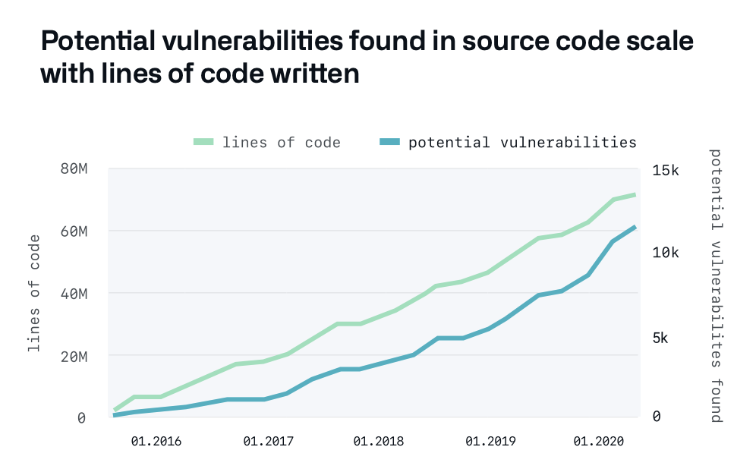
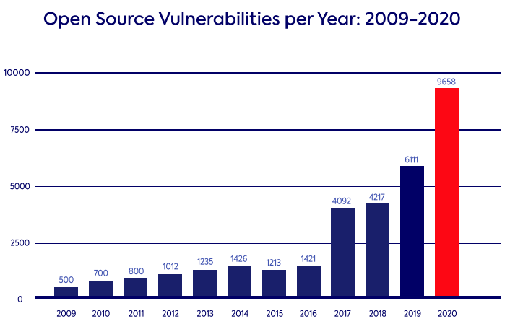
The number of vulnerabilities “in the wild” outpaces the speed at which the security community can patch or even identify them. And each day, the world contains more lines of source code than it ever has before
Source: Github State of the Octoverse 2020
Source: Github State of the Octoverse 2020
Source: Whitesource State of Open Source Security 2021
Vulnerabilities seem to scale with lines of code - but other metrics besides LOC show similar patterns
The number of reported vulnerabilities in open source codebases is growing each year
Every year, more lines of OSS are written than ever before, but vuln detection lags years behind
+
=
Notes:
JF every year, we write more lines of source code than ever before. For example,
In 2020, 60 million new repos were created on GitHub, with around 1.9 billion contributions.
Vulnerabilities seem to scale with lines of code - but other metrics besides LOC show similar patterns
We also see that The number of reported vulnerabilities in open source codebases is growing each year - and furthermore, we have reasons to believe that the number of vulns being reported is radically lower than the total number of exploitable vulnerabilities in the wild.
“Open Source Vulnerabilities per Year: 2009-2020” graph sourced from: https://www.whitesourcesoftware.com/resources/blog/2021-state-of-open-source-security-vulnerabilities-cheat-sheet/
“Potential vulnerabilities found in source code scale with lines of code written” graph sourced from Github 2020 State of the Octoverse security report: https://octoverse.github.com/static/github-octoverse-2020-security-report.pdf

Slide 15
Together

Slide 16
User responsibility
If you consume it, you need to monitor it and upgrade it
Different from vendor software → get an individual alert, analysis specific to your use case
Maintainers don’t know who’s running their projects, their environment, or what they’re using it for
Log4j → “Am I affected?” “Please fill out my company’s incident response form”
Isn’t the relationship between OSS maintainers and users
Notes:
Anne

Slide 17

Moving beyond “responsible consumption”...
“If you use software from a project, maybe you could contribute back to that project?”
A very wise person
Image - Blown Cat
Notes:
CR

Slide 18

COORDINATED APPROACH - WHY AND HOW
Image - Eek!
Notes:
CR

Slide 19
What is needed to make open source more secure?
Threat model to understand the many places & times at which a project can be compromised.
Data-driven identification of the world’s most critical open source projects
Interventions to prevent vulnerabilities in the first place, introduced at various parts of SDLC
Preventing inherited security debt through tools that can help developers obtain and users assess the security of a project (such as the OSSF Best Practices badge and OSSF Scorecards)
Continued research and open source tool development for scalable bug-hunting & remediation
Investments in technical security reviews of critical open source projects,
Coordinated patching and incident response support to respond to high-impact vulnerabilities in OSS
Better vulnerability disclosure processes, response, and workflows.
Coordinated, impact-prioritized funding for security improvements, audits, and research
Notes:
JF/CR?
What is needed to make open source more secure?
Articulating a cohesive threat model of the open source ecosystem, to identify and communicate to developers, maintainers, and users the many places and points in time at which a project can be compromised.
A shared, data-driven identification of the world’s most critical open source projects, to help prioritize the allocation of resources (including funding for security reviews and improvements) toward these widely-deployed, high-impact codebases. Identifying the most critical open source projects - even if these aren’t always the obvious projects - to help prioritize the allocation of resources toward these widely-deployed, high-impact codebases.
Interventions to prevent vulnerabilities in the first place, introduced at various places in the development lifecycle. This could include everything from safe(r) programming languages, to developer education programs, as well as free and usable program analysis tooling.
Preventing inherited security debt through tools that can help developers obtain and users assess the security of a project (such as the CII Best Practices badge)
Continued research and open source tool development to scalably find as many vulnerabilities as possible in a codebase in a repeatable and automated way, and integrating this into build pipelines. .
Investments in technical security reviews of critical open source projects, to help uncover and remediate vulnerabilities the tools may have missed in our most important, widely-used, or foundational open source projects.
Coordinated patching and incident response support to respond to high-impact vulnerabilities in open source software
Better vulnerability disclosure processes, response, and workflows with OSS maintainers.
Coordinated, prioritized funding for security improvements, audits, and research, ideally allocated in a coordinated and strategic way so that it can do the most good for the ecosystem as a whole.

Slide 20
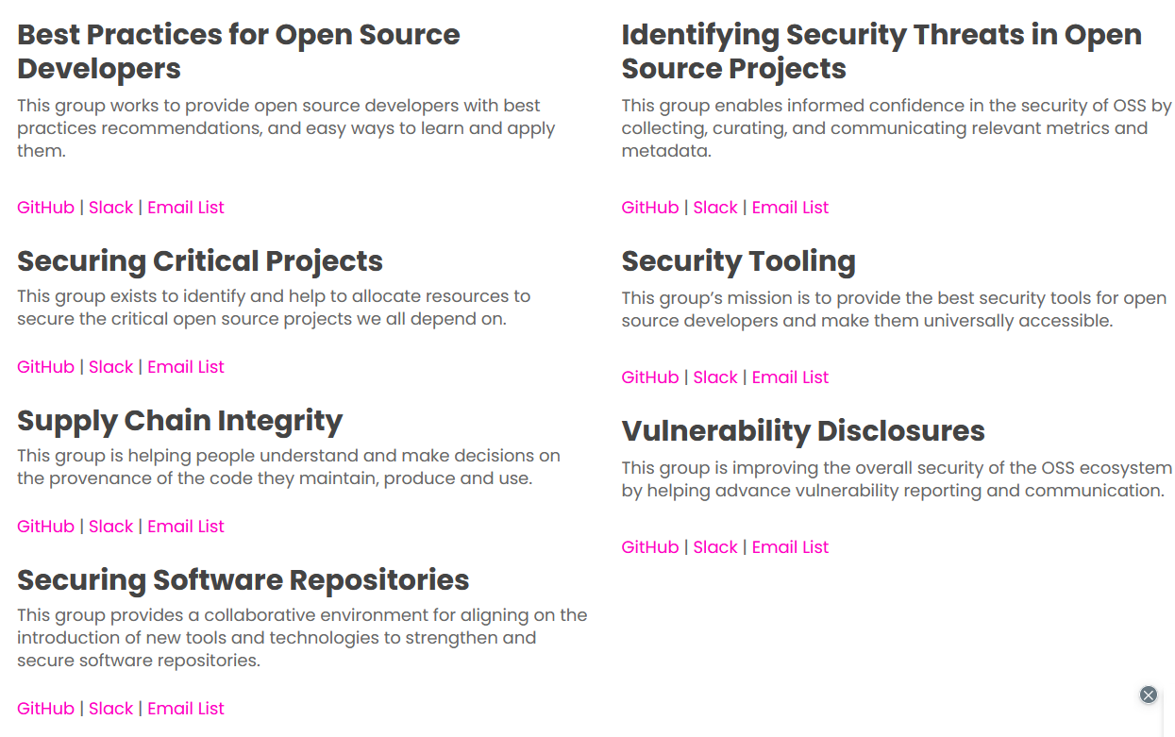
OSSF Working Groups
Notes:
CRob

Slide 21
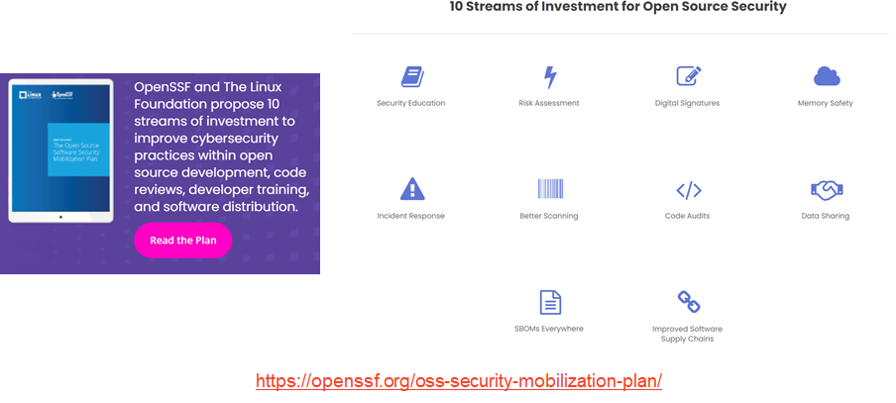
Someone IS doing something
…and you can help!
Notes:
CRob

Slide 22

Thank you!
openssf.org/getinvolved
github.com/ossf
@whyhiannabelle
@SecurityCRob

